Slide 1
Minimum Exposure Approach for Trustworthy Vertical Federated Learning
Dashan GAO
Supervisor: Prof. Qiang YANG
Co-supervisor: Prof. Xin YAO
Notes:
Good morning, dear professors.
Thank you for taking the time to attend my thesis defence.
Today, I am honored to share my thesis titled: “Minimum-Exposure Approach for Trustworthy Vertical Federated Learning.”
This thesis is supervised by Professor Qiang Yang, and co-supervised by professor Xin Yao when he was in SUSTech, now professor Xin Yao works in Lingnan university.

Slide 2
Contents
1. Introduction
2. Vertical Federated Learning
3. LPSC: Label Privacy Source Coding in VFL (ECML PKDD 2024)
4. CKD: Complementary Knowledge Distillation in VFL (AAAI 2024)
5. VFDC: Secure Dataset Condensation for Privacy-Preserving and Efficient VFL (ECML PKDD 2024)
6. PP-HFTL: Privacy-Preserving Heterogeneous Federated Transfer Learning (IEEE Big Data 2019)
7. Conclusions
Notes:
This slide outlines the structure of my thesis.
I will begin by introducing the background and motivation for trustworthy vertical federated learning (VFL).
In the second part, I will provide a brief overview of VFL and introduce our proposed concept of Minimum-Necessary Information Exposure (MNIE).
Following that, I will present four published works, each addressing a specific aspect of MNIE to achieve trustworthy VFL.
Finally, I will conclude the thesis by summarizing the key contributions.

Slide 3
Background
Data privacy attracts growing attention.
Strict regulations such as GDPR are formulated.
Notes:
As AI becomes increasingly pervasive, data privacy attracts growing attention.
Large companies such as Facebook were involved into data leakage.
To protect data privacy, strict regulations on data protection are formulated, such as GDPR,
which require companies to take a higher-level protection on user data privacy.

Slide 4
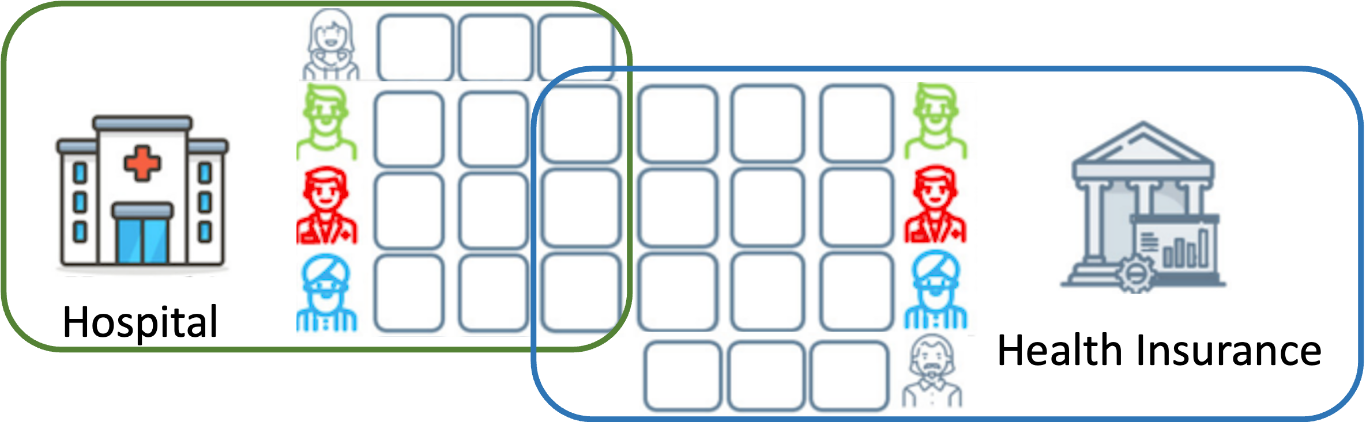
Background
Federated Learning [McMahan et al., 2016] is a paradigm that enables learning from separated parties in a privacy-preserving manner.
Data are distributed and privacy-sensitive.
Labeled data are insufficient in each single party.
Vertical Federated Learning (VFL) was proposed by [Yang et al., 2019].
Different feature spaces in each party.
Common in cross-enterprise scenarios.
H. Brendan McMahan, Eider Moore, Daniel Ramage, and Blaise Agüeray Arcas. Federated learning of deep networks using model averaging. CoRR,abs/1602.05629, 2016.
Qiang Yang, Yang Liu, Tianjian Chen, and Yongxin Tong. Federated machine learning: Concept and applications. ACM Trans. Intell. Syst. Technol., 10(2), Jan 2019.
Notes:
As a response, Federated Learning was introduced by google in 2016.
It enables separated parties to collaboratively train their private data in a privacy-preserving manner.
To address scenarios where feature spaces differ across parties, Vertical Federated Learning was proposed by professor Qiang Yang and his collaborators in 2019.
VFL specifically targets cross-enterprise scenarios, where each party is a institution that holds different feature spaces and shared samples.

Slide 5



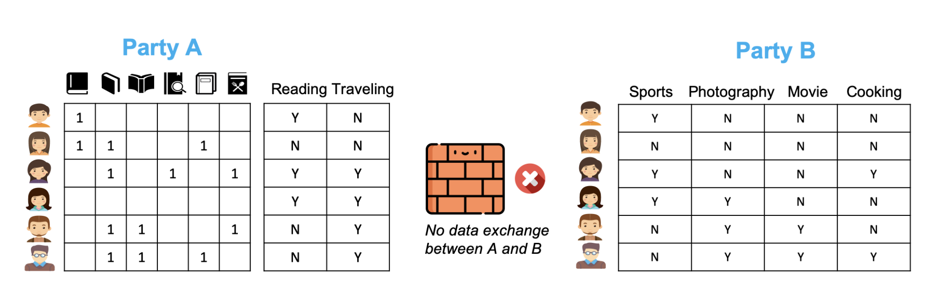

Example: Information Exposure in Naive VFL [Visa Research, 2023]
Active Party
Passive Party
Labels repetitively
learned by two parties
Features similar to those of active party.
💰
Age
♂/♀
....
Similar
samples
Naive VFL trains on the entire dataset, including similar samples and features. The exposure of unnecessary information leads to privacy risks and inefficiencies without extra utility gains.
Visa Research. (2023). Secure collaborative machine learning. https://usa.visa.com/dam/VCOM/regional/na/us/about-visa/research/documents/secure-collaborative-machine-learning.pdf
Notes:
There exists various information exposure in VFL.
We use two examples to highlight how information exposure impacts the trustworthiness of VFL.
Now, let me demonstrate the first example of Naive VFL.
This example, adapted from Visa Research (2023), illustrates a naive VFL scenario. In this setup:
1. The active party, such as a bank, has labeled features, while the passive party, like a credit card company, contributes features of the same set of users.
2. Naive VFL trains on the entire dataset, including both similar samples and features across the two parties.
3. This approach results in the repeated learning of labels and features, which unnecessarily increases the exposure of sensitive information
The lack of optimization in data utilization not only increases privacy risks but also reduces the overall efficiency of the system without providing additional utility.

Slide 6
Example: Information Exposure in Ideal VFL [Visa Research, 2023]
Active Party
Passive Party
Labels processed
for passive party
Removed features
💰
Age
♂/♀
....
[Gao et al., 2024]
[Castiglia et al., 2023]
VFL
training
Removed
samples
[Huang et al., 2022]
Ideal VFL minimizes the unnecessary information exposure by removing similar samples and features while maintaining utility.
Castiglia, T., Zhou, Y., Wang, S., Kadhe, S., Baracaldo, N., & Patterson, S. (2023). LESS-VFL: Communication-Efficient Feature Selection for Vertical Federated Learning. Proceedings of the 40th International Conference on Machine Learning, 202:3757-3781.
Huang,L.,Li,Z.,Sun,J.,Zhao,H.:Coresetsforverticalfederatedlearning:Regularizedlin- ear regression and k-means clustering. Advances in Neural Information Processing Systems 35, 29566–29581 (2022)
Notes:
Building on the previous example, this slide demonstrates how ideal VFL minimizes unnecessary information exposure while maintaining model utility.
1. In this scenario, redundant features in the passive party are identified and removed
2. Similarly, redundant samples that contribute little to the training process are filtered out
3. Additionally, the labels processed for the passive party are selectively handled, leveraging techniques from our own work.
By optimizing the training dataset through these techniques, ideal VFL significantly reduces privacy risks and improves efficiency, without sacrificing performance.
This example demonstrates the potential of an optimized VFL approach to address both privacy and utility challenges in cross-enterprise scenarios.

Slide 7
Overarching Philosophy of This Thesis
“Everything should be made as simple as possible, but not simpler.”
— Albert Einstein
Explanation in trustworthy VFL:
Excessive information exposure does not improve utility but only increases privacy and efficiency risks.
Conversely, insufficient information exposure can harm utility, leading to inevitable utility-privacy-efficiency trade-offs.
Therefore, we pursue Minimum-Necessary Information Exposure (MNIE).
Notes:
The overarching philosophy of this thesis can be depicted by Albert Einstein’s quote:
“Everything should be made as simple as possible, but not simpler.”
In the context of trustworthy VFL:
It drives us to find an optimal/nuanced extent of information exposure, beyond which,
• Excessive information exposure does not improve utility but rather increases privacy and efficiency risks.
• Conversely, insufficient information exposure can harm utility, requiring us to carefully balance privacy, utility, and efficiency.
To achieve this, we pursue Minimum-Necessary Information Exposure (MNIE).
This principle serves as the foundation of this thesis and will be elaborated later.

Slide 8
Contents
1. Introduction
2. Vertical Federated Learning
Vertical Federated Learning Overview
Minimum-Necessary Information Exposure
3. LPSC: Label Privacy Source Coding in VFL (ECML PKDD 2024)
4. CKD: Complementary Knowledge Distillation in VFL (AAAI 2024)
5. VFDC: Secure Dataset Condensation for Privacy-Preserving and Efficient VFL (ECML PKDD 2024)
6. PP-HFTL: Privacy-Preserving Heterogeneous Federated Transfer Learning (IEEE Big Data 2019)
7. Conclusions
Notes:
Next I will introduce the overview of VFL and the concept of our proposed minimum-necessary information exposure.

Slide 9
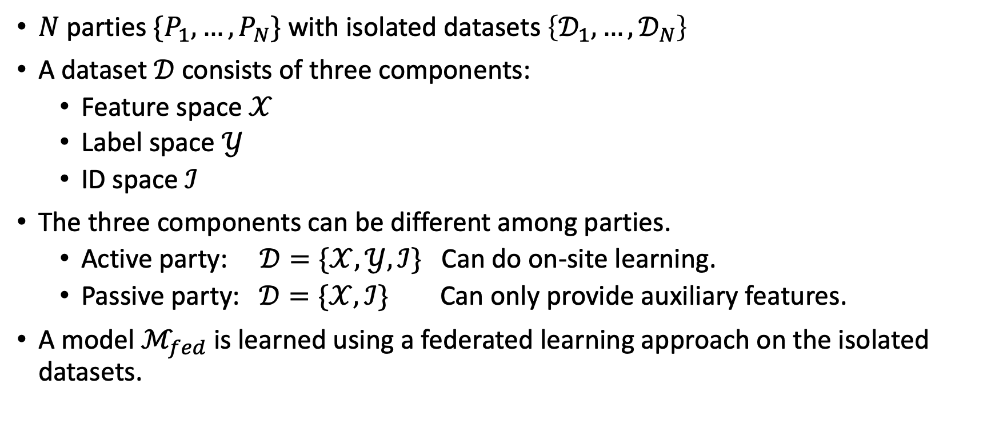
Vertical Federated Learning – Definition extending from [Yang et al., 2019]
$N$ parties $\{P_{1}, …,P_{N}\}$ with isolated datasets $\left\{𝒟_{1},…,𝒟_{N}\right\}$
A dataset $𝒟$ consists of three components:
Feature space $𝒳$
Label space $𝒴$
ID space $ℐ$
The three components can be different among parties.
Active party: $𝒟=\{𝒳, 𝒴,ℐ\}$ Can do on-site learning.
Passive party: $𝒟=\{𝒳,ℐ\}$ Can only provide auxiliary features.
A model $ℳ_{fed}$ is learned using a federated learning approach on the isolated datasets.
Notes:
In VFL, we have N parties ...

Slide 10
Multi-objective Trade-offs in VFL
There are multi-objective trade-offs in trustworthy VFL:
Utility: improve the model performance.
Efficiency: efficiently train the VFL model.
Privacy: protect data asset and user privacy.
This thesis aims to find unified approaches to improve these objectives.
Active Party
Passive party
Notes:
There are multiple objectives of trustworthy VFL and we face trade-offs among these objectives.
For example,

Slide 11
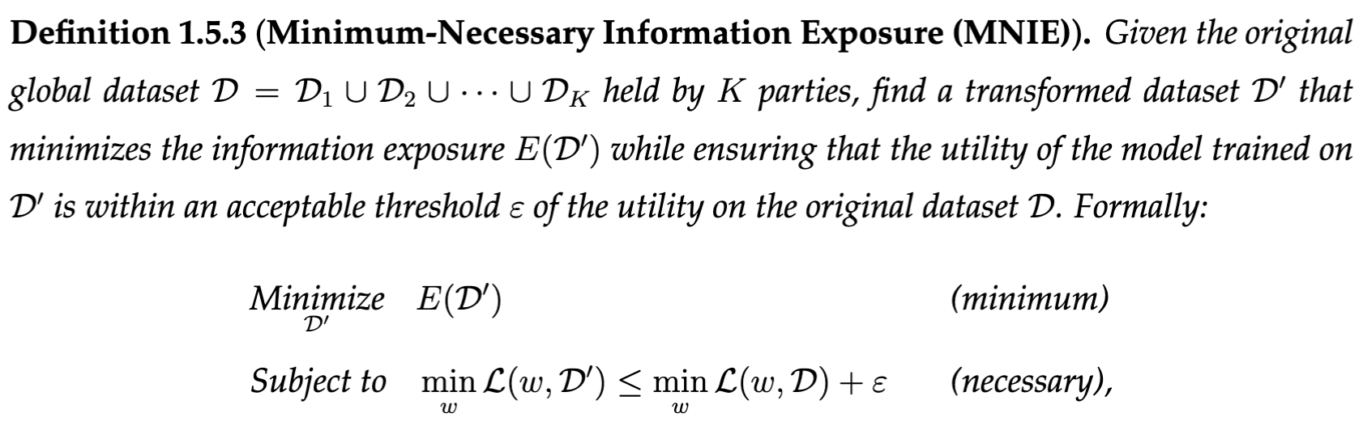
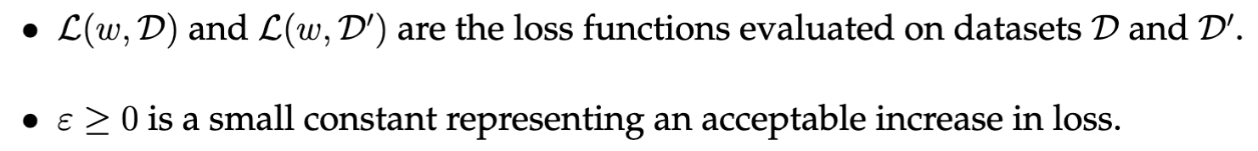
Definition of Minimum-Necessary Information Exposure (MNIE)
We formally define the concept of minimum-necessary information exposure in trustworthy VFL.
where:
Notes:
Now, we formally define the concept of MNIE as a methodology to address the multi-objective trade-offs in trustworthy VFL.
We assume K parties jointly hod a a global dataset D, MNIE finds a transformed dataset D’ that minimizes the information exposure E(D’) while ensuring the utility of the model trained on D’ is within an acceptable threshold of the utility of the original dataset D.
The minimization term ensures minimal information exposure to ensure privacy and efficiency,
and the constraint term ensures the necessary information exposure to maintain the utility.

Slide 12
Our Works Categorized from Two Perspectives
Our works categorized from transfer learning perspective.
Our works categorized based on the information exposure perspective. This categorization is followed throughout the presentation.
Figure 2.1
Figure 2.2
Notes:
We can categorize our works from two perspectives.
• On the left, we present the categorization of problem settings from transfer learning perspective.
which can be divided into vanilla VFL and hetero FTL.
For FTL, knowledge can be transferred among parties through either shared samples, shared features or label space, corresponding to sample-sharing, feature-sharing, and label-sharing types.
Representative methods and corresponding works are listed for each category.
• On the right, we define the categorization of MNIE within VFL.
The information exposure can be divided into two main types: Data Exposure and Model Parameter Exposure.
Data exposure is further broken down into minimizing intra-sample and inter-sample exposure, while model parameter exposure focuses on exposing minimal model parameters.
This categorization is followed throughout the presentation.

Slide 13
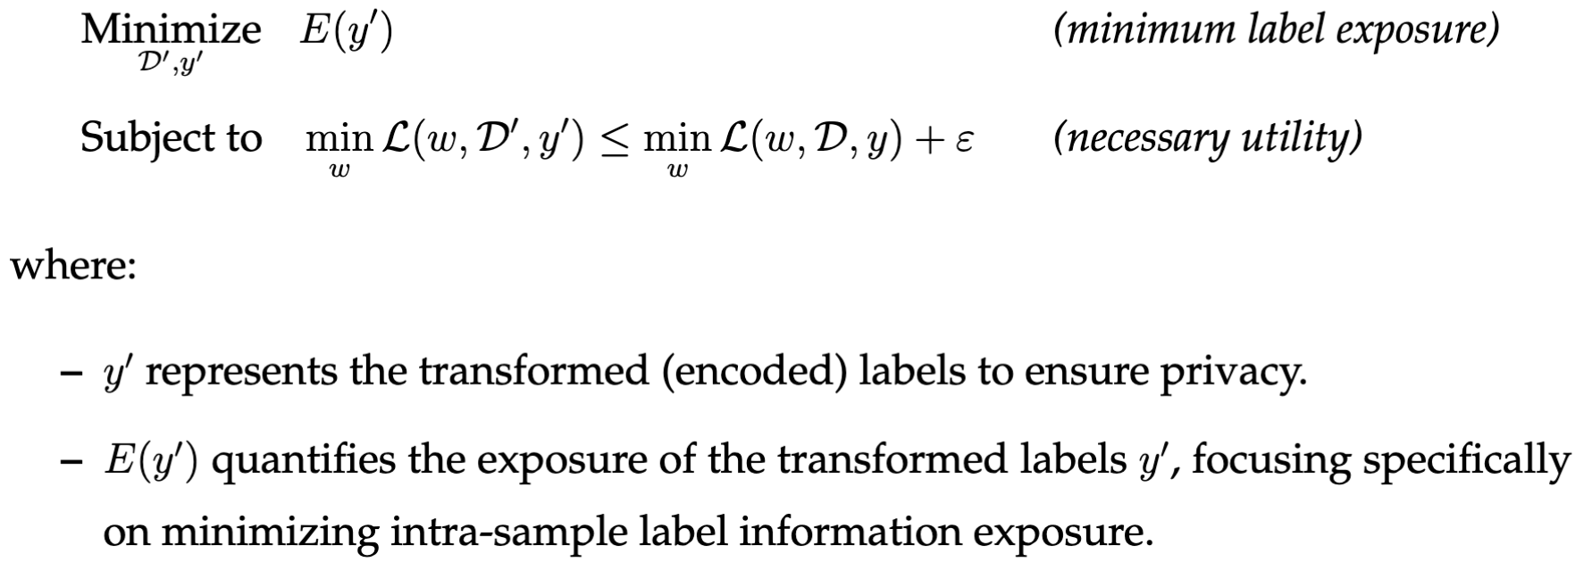
Minimize Intra-Sample Label Exposure (LPSC Chapter 3, CKD Chapter 4)
Encode original labels to minimize label information exposure for privacy.
Ensure effective VFL model training to maintain utility.
Adapted MNIE objective function:
Notes:
Before introducing each published work, we first overview the three types of MNIE corresponding to our four works.
First, to minimize intra-sample data exposure, we aim to encode original labels for label privacy protection against the passive parties.
The original MNIE objective is adapted by transforming the original label information y to a encoded label information y’.
And taking y' as the new learning target in VFL.

Slide 14
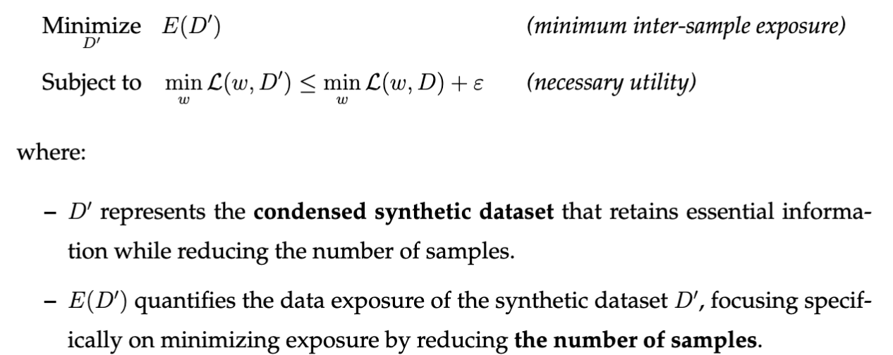
Minimize Inter-Sample Data Exposure by Dataset Condensation (VFDC, Chapter 5)
Generate condensed synthetic dataset for privacy and efficiency improvement while maintaining utility.
Adapted MNIE objective function:
Notes:
Second, to minimize the inter-sample data exposure, we can generate a small condensed synthetic dataset to improve privacy and efficiency.
The original MNIE objective is adapted by setting D’ as the condensed synthetic dataset of the original dataset D.

Slide 15
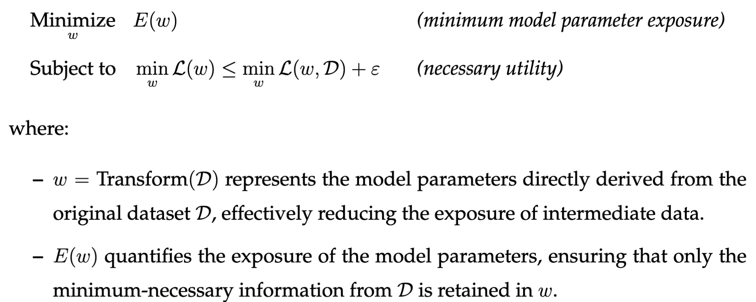
Expose Model Parameters Only via Secure Computation (PP-HFTL, Chapter 6)
Directly transform original dataset to model parameters via secure computation, to achieve high utility and strong privacy protection.
Adapted MNIE objective function:
Notes:
Lastly, to expose the model parameters only, we can directly transform the original dataset to model parameters via secure computation, to achieve high utility and strong privacy.
In the adapted MNIE objective, the transformed dataset is set D to be the trained model parameters w.

Slide 16
Contents
3. LPSC: Label Privacy Source Coding in VFL (ECML PKDD 2024)
Notes:
In this section, we introduce our proposed label privacy source coding method to tackle the intra-sample data exposure, for label privacy protection.

Slide 17
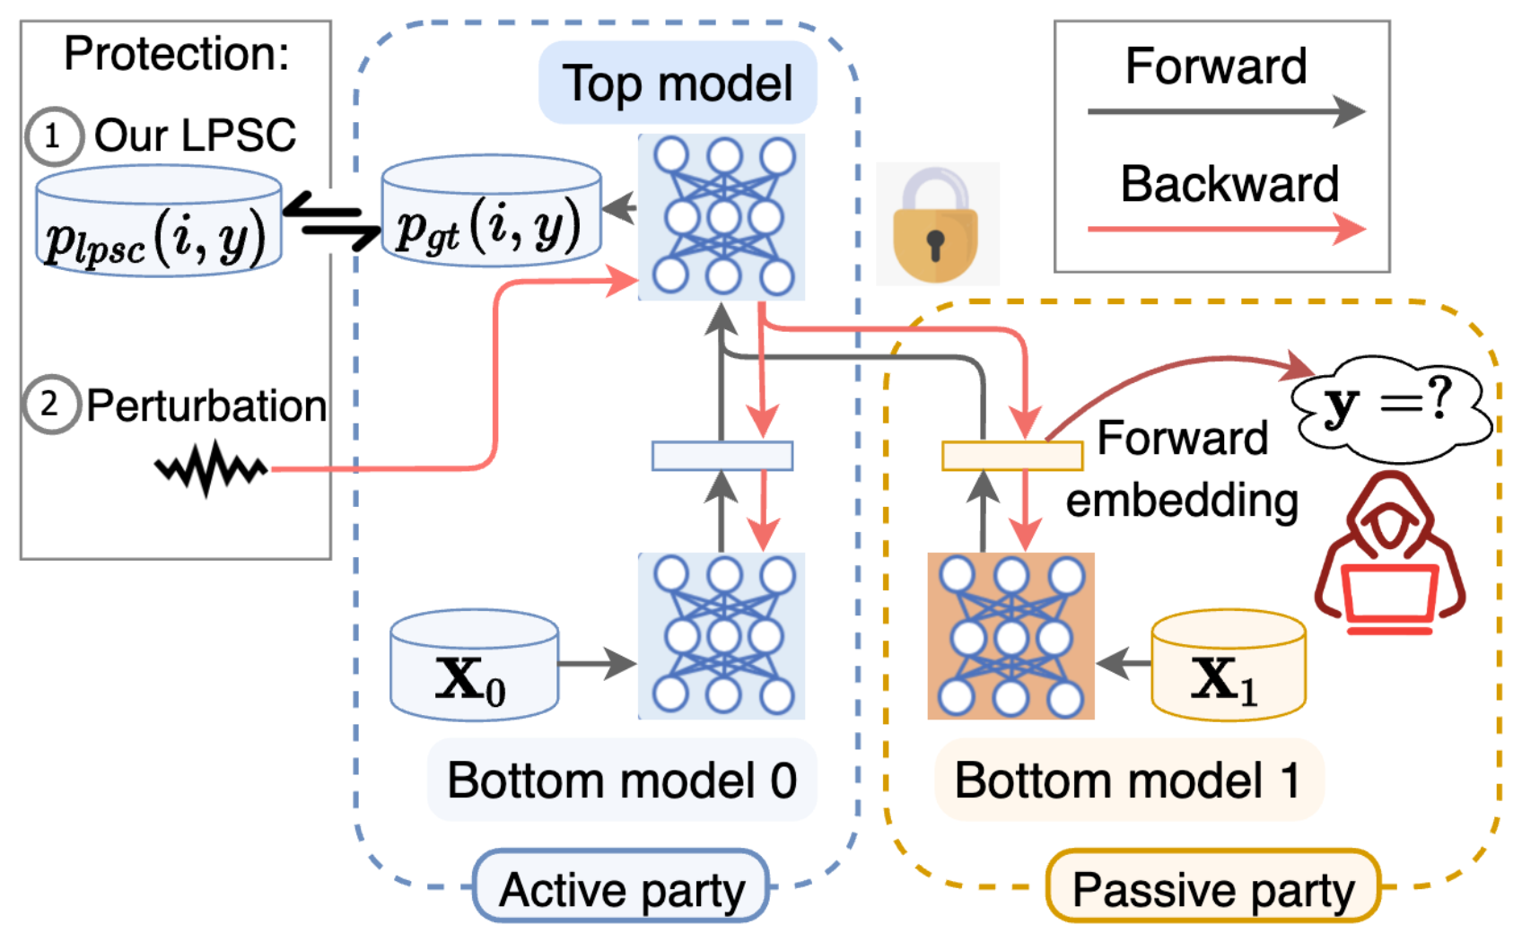
Vanilla VFL and Privacy Threats
Existing methods [Li et al., 2022, Fu et al., 2022]:
Adopt a model-splitting paradigm:
Top model protects label.
Bottom models protect features.
Dilemmas: existing perturbation methods leads to privacy-utility trade-off.
Fundamental cause: directly train forward embeddings to fit labels, which contains unnecessary information exposure.
Figure 3.1: Vanilla VFL and label privacy threat
Oscar Li, Jiankai Sun, Xin Yang, Weihao Gao, Hongyi Zhang, Junyuan Xie, Virginia, Smith, and Chong Wang. Label leakage and protection in two-party split learning. International Conference on Learning Representations (ICLR), 2022.
Chong Fu, Xuhong Zhang, Shouling Ji, Jinyin Chen, Jingzheng Wu, Shanqing Guo, Jun Zhou, Alex X. Liu, and Ting Wang. Label inference attacks against vertical federated learning. In 31st USENIX Security Symposium (USENIX Security 22), pages 1397–1414, Boston, MA, August 2022. USENIX Association.
Notes:
Existing methods adopt a model-splitting paradigm:
As shown in the figure, each party has a bottom model that maps features to forward embeddings. Active party has a top model to predict label.
Existing methods use training-phase perturbation to get a complex-yet-deterministic top model.
Dilemmas:
privacy-utility trade-off due to perturbation
Fundamental reason is that they directly train forward embeddings to fit labels. and update Passive parties’ bottom models gradients with respect to labels.
Do not remove the prior label information in $X_{0}$from labels.

Slide 18
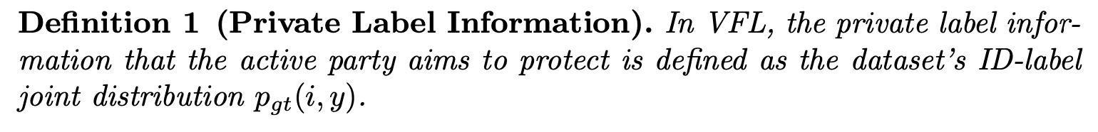
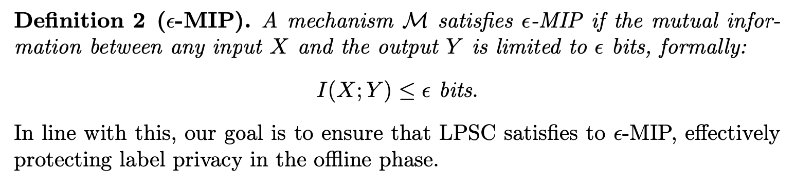
Preliminary: Privacy
Private label information is defined as the ID-label joint distribution.
Mutual Information Privacy (MIP) can be used to measure the label information leaked to the passive party in VFL.
Notes:
We first define the private label information as the ID-label joint distribution.
We leverage the notion of mutual information privacy to measure the label information leaked to the passive party.
The privacy leakage from input X to output Y is quantified as their mutual information.

Slide 19
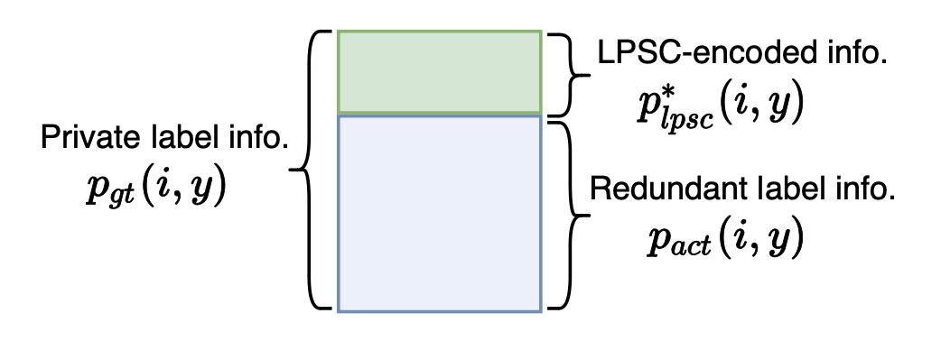
Insight of Label Privacy Source Coding (LPSC)
We aim to propose an optimization problem to encode the minimum-necessary label information in the original label information.
Therefore, we propose Label Privacy Source Coding (LPSC).
minimum-necessary
label information
unnecessary and redundant
label information
Figure 3.2: The schematic graph of LPSC.
Notes:
We aim to propose an optimization problem to encode the minimum-necessary label information from the ground-truth label information.
As shown in this schematic graph, the blue rectangle denotes the label information that the active party can learn from its local features. (recall that the active party has labeled features.)
The green rectangle corresponds to the remaining label information that is not learned by the active party locally. And should be learned during VFL with the help of the passive parties.
Therefore, intuitively, the green part indicates the minimum-necessary label information that should be learned in VFL.
Our proposed LPSC aims to encode the green part for VFL training, by removing the blue part (redundant label info) out of the entire ground-truth label info.

Slide 20
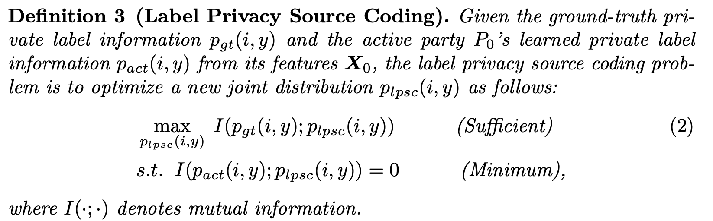
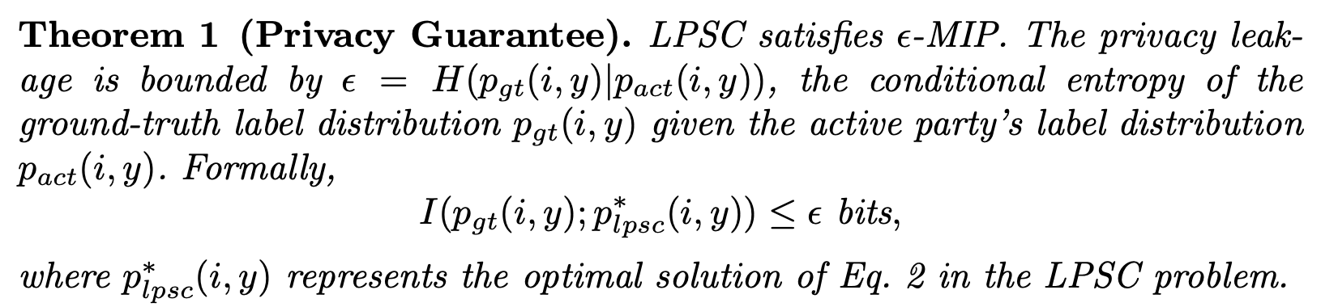
Label Privacy Source Coding Problem
We encode minimum-necessary label information as follows:
(necessary, utility)
(minimum, privacy)
Mutual Information Privacy (MIP)-based privacy guarantee
Notes:
To achieve our insight, we define the LPSC problem to encode minimum-necessary label information.
By constraining the mutual information between active party’s learned label information and the LPSC-encoded label info as zero, we achieve minimum information exposure, and protect label privacy.
By maximizing the mutual information between groundtruth label info and LPSC-encoded label info, we preserve the necessary label information for high utility.
MIP guarantees that label privacy leakage from LPSC-encoded results is guaranteed depending no the active party’s learned label information.

Slide 21
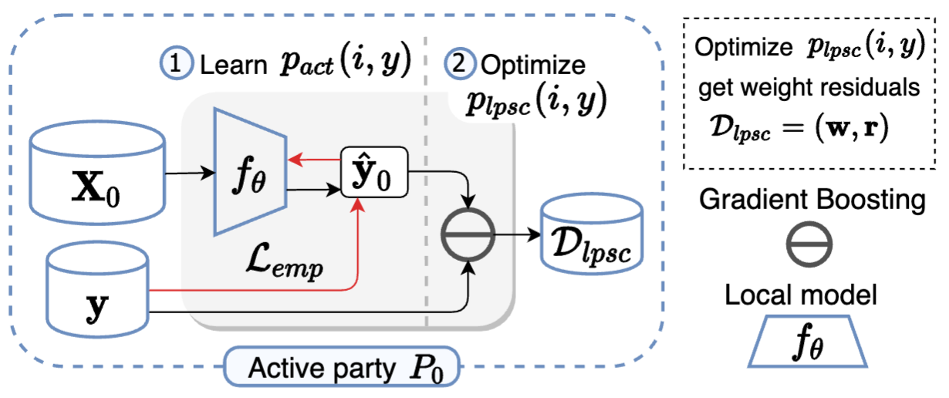
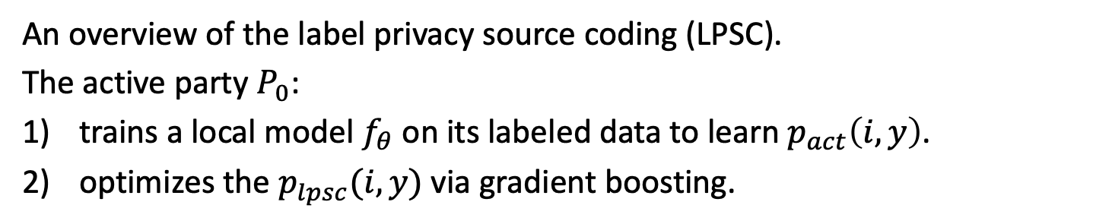
Label Privacy Source Coding
An overview of the label privacy source coding (LPSC).
The active party $P_{0}$:
trains a local model $f_{θ}$ on its labeled data to learn $p_{act}\left(i,y\right)$.
optimizes the $p_{lpsc}(i,y)$ via gradient boosting.
Notes:
To perform LPSC, the active party first locally learns the label information by training a local model.

Slide 22
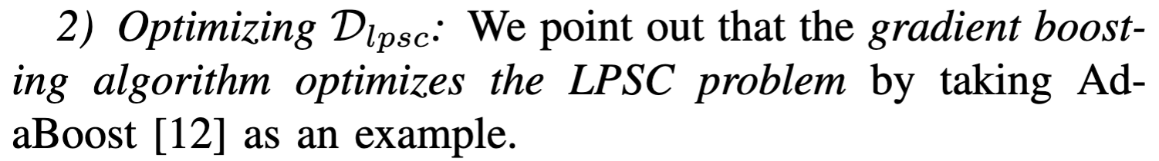
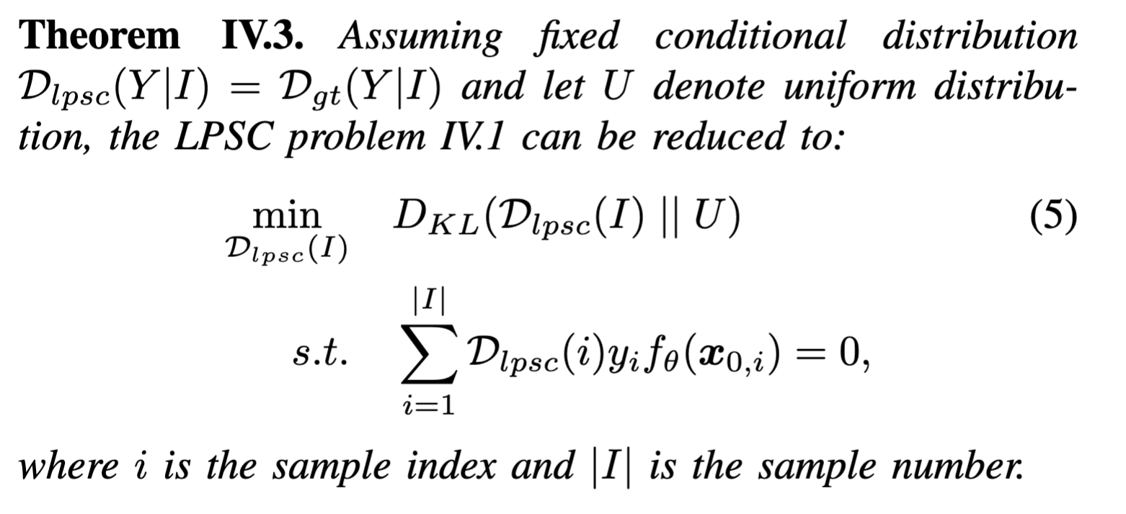
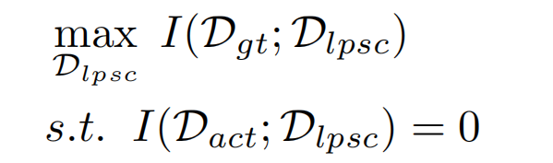
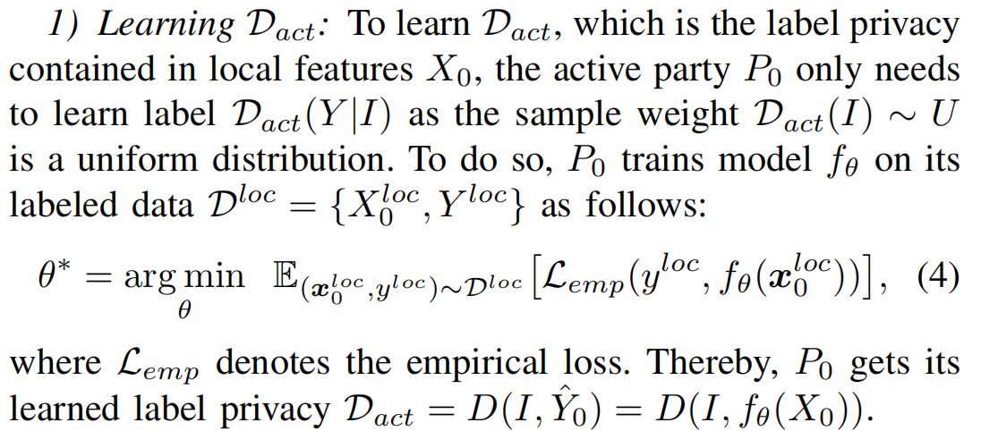
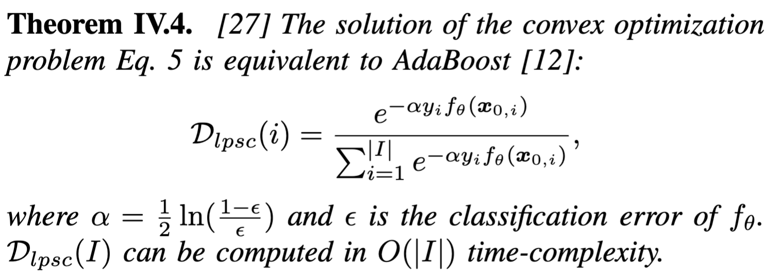
Gradient Boosting Solves LPSC
We prove that gradient boosting can efficiently optimize LPSC.
(necessary, utility)
(minimum, privacy)
Notes:
After predicting D_act, the active party can optimize the LPSC problem to obtain the encoded label information.
We demonstrate that the LPSCS problem can be reduced to the AdaBoost algorithm, and each training sample is assigned with a new sample weight.
Therefore, the LSPC-encoded label information can be defined as the re-weighted labels.

Slide 23
LPSC+ Framework for Flexible Privacy-Utility Trade-off
LPSC provides upper-bounded label privacy protection, which may not achieve satisfactory privacy protection.
Therefore, we introduce adversarial training to enable flexible privacy-utility trade-off and provide stronger privacy protection.
minimum-necessary
label information
unnecessary and redundant
label information
Figure 3.2: The schematic graph of LPSC.
Notes:
Let’s recall this schematic graph of LPSC, the LPSC-encoded label information is determined by the active party’s learned redundant label information, the blue part.
That is, when the active party learns too little label knowledge from its local features, the LPSC may encode too much label information, which may lead to excessive and unsatisfactory privacy leakage.
Therefore, we should flexibily adjust the label information used to train the passive party, on the basis of LPSC.
We introduce adversarial training to enable flexible privacy-utility trade-off and provide stronger privacy protection.

Slide 24
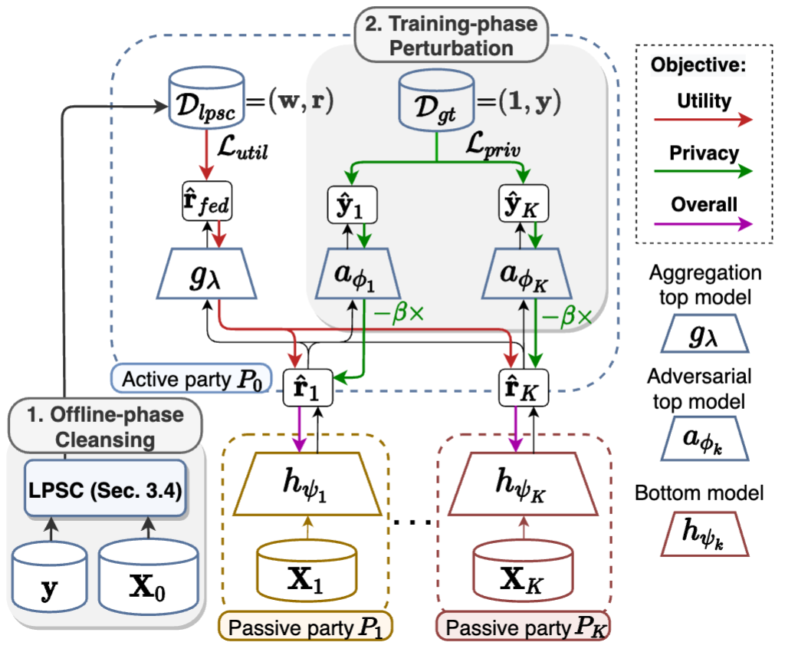
LPSC+ Framework
The framework of LPSC+Adv with two phases:
Offline phase: LPSC encodes minimum-necessary label information.
Federated training phase: a federated model is trained via a utility loss and privacy loss to enable trading utility for extra privacy.
Figure 3.3

Slide 25
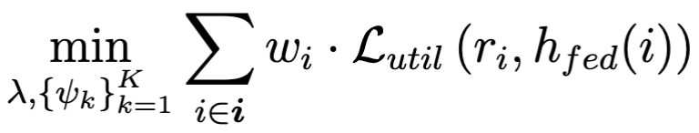
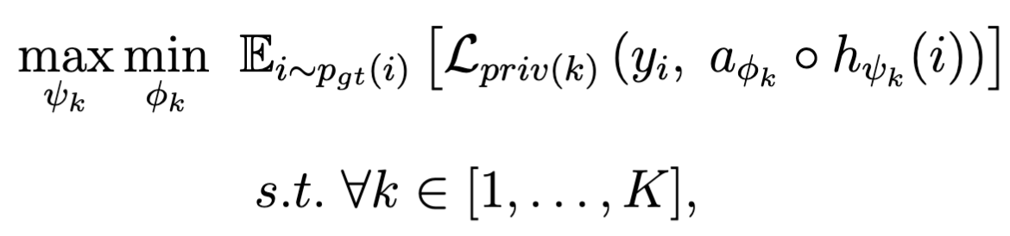
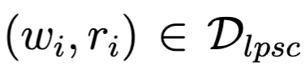
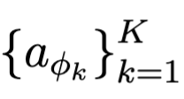
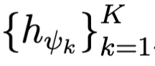
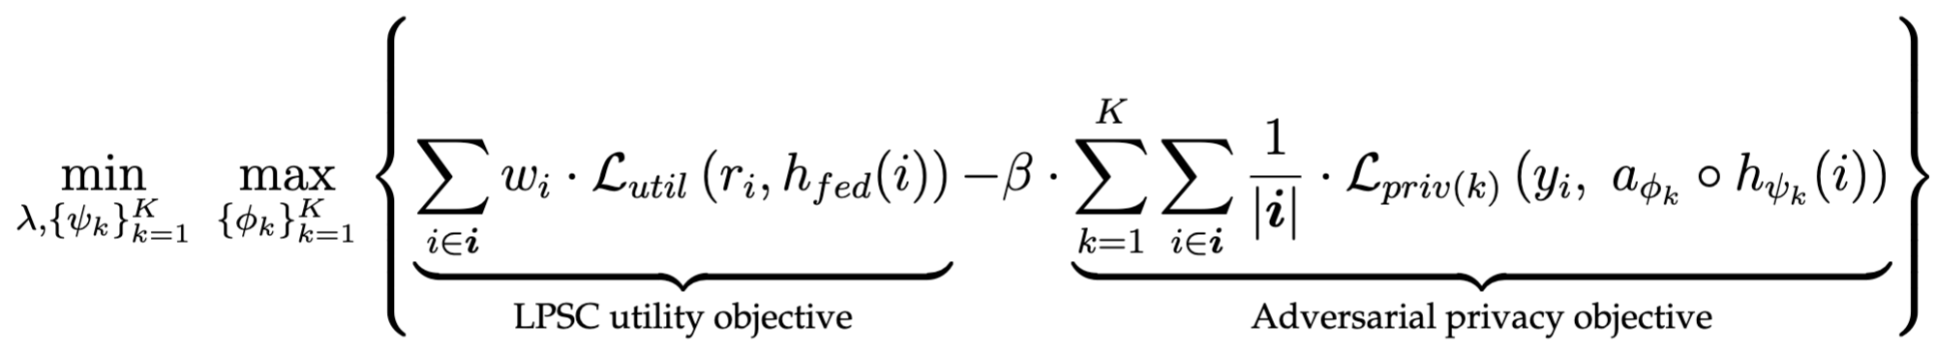
LPSC+Adv Framework Objectives
LPSC Utility Objective
Adversarial Privacy Objective
: LPSC-encoded weight-residuals.
: adversarial top models
: bottom models
Overall Objective

Slide 26
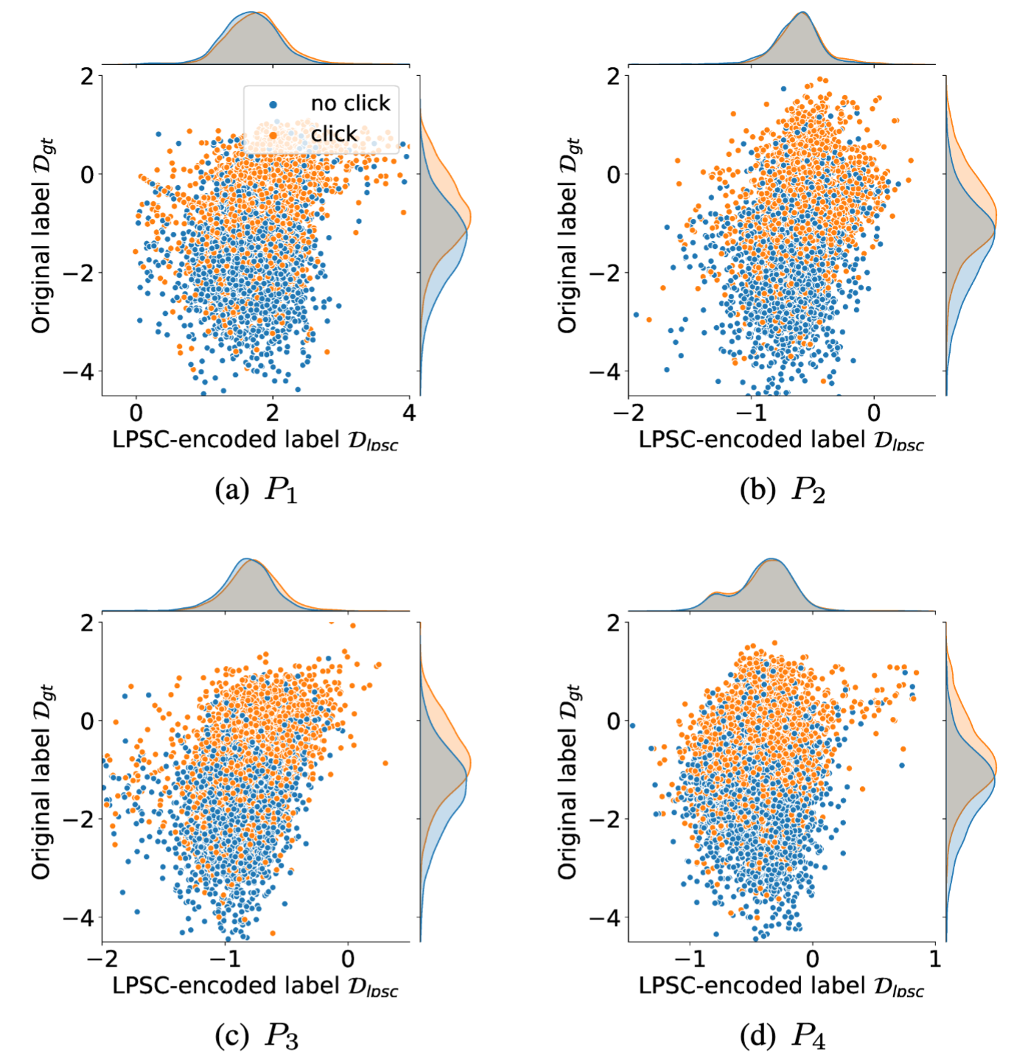
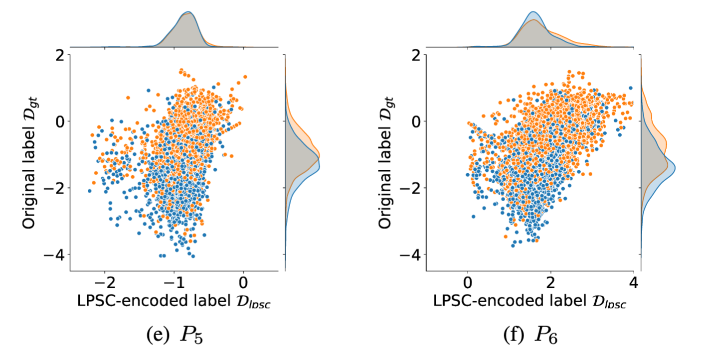
Experiments: Visualization of Passive Party’s Model Output
Figure 3.4 visualizes the distributions of output logits by fitting original labels v.s. LPSC-encoded labels for 6 passive parties.
It is more challenging to distinguish the output distributions between classes when the bottom models are trained with LPSC-encoded labels.
Figure 3.4

Slide 27
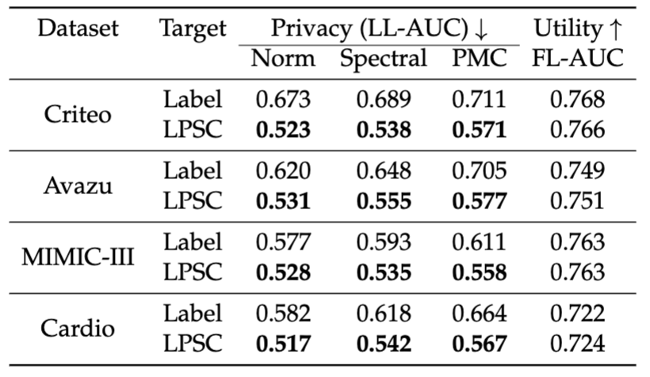
Experiments: LPSC Protects Label Privacy for Free
Table 3.1 presents the Label Leakage LL-AUC against Norm, Spectral, and PMC attacks and the FL-AUC on four datasets.
The LL-AUC of LPSC against three attacks is significantly lower than that of the original labels. → LPSC provides strong label privacy protection.
The FL-AUC of LPSC is comparable to that of the original labels. → LPSC does not sacrifice model utility.
Table 3.1: Comparative results of privacy and utility of VFL fitting original labels vs. LPSC-encoded labels.

Slide 28
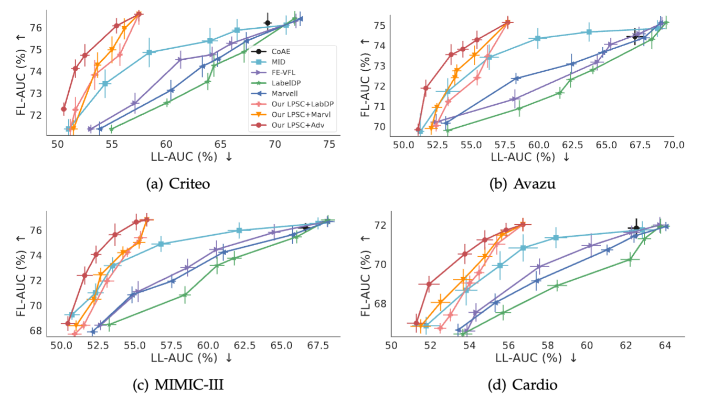
Experiments: Privacy-Utility Trade-off Comparison
Figure 3.5 shows the privacy-utility trade-off curves on four datasets.
An ideal trade-off should have a large FL-AUC and a small LL-AUC, thus in the upper-left corner.
Our LPSC + adversarial training is the closest to the ideal trade-off on all four datasets.
Figure 3.5: Privacy-utility trade-off of different protection methods against the Passive Model Completion (PMC) attack on four datasets.

Slide 29
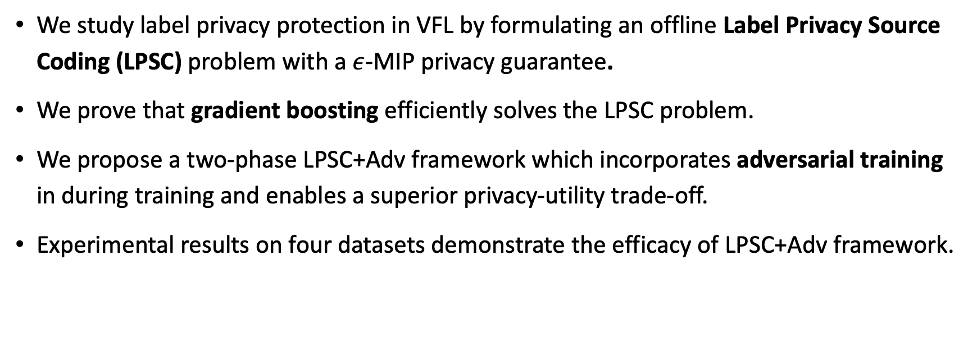
Conclusion
We study label privacy protection in VFL by formulating an offline Label Privacy Source Coding (LPSC) problem with a $ε$-MIP privacy guarantee.
We prove that gradient boosting efficiently solves the LPSC problem.
We propose a two-phase LPSC+Adv framework which incorporates adversarial training in during training and enables a superior privacy-utility trade-off.
Experimental results on four datasets demonstrate the efficacy of LPSC+Adv framework.

Slide 30
Contents
4. CKD: Complementary Knowledge Distillation for Robust and Privacy-Preserving Model Serving in VFL (AAAI 2024)

Slide 31
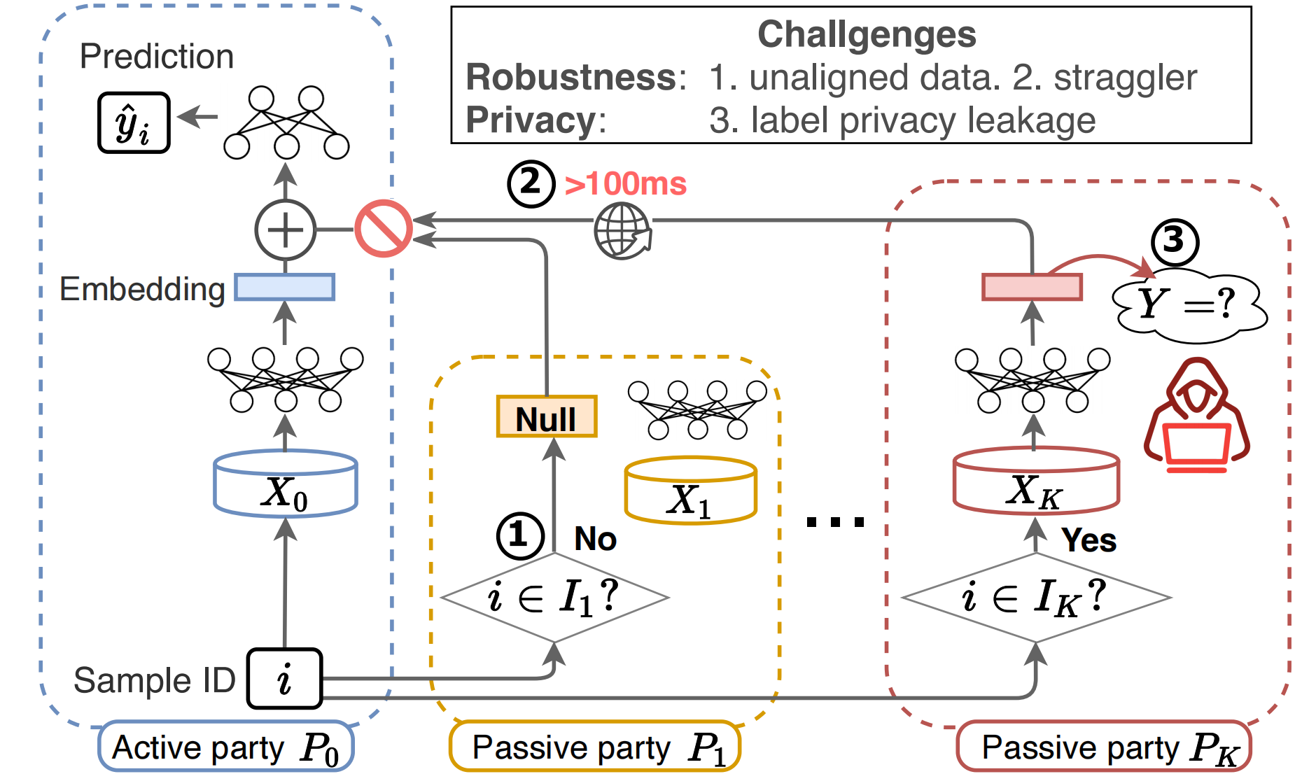
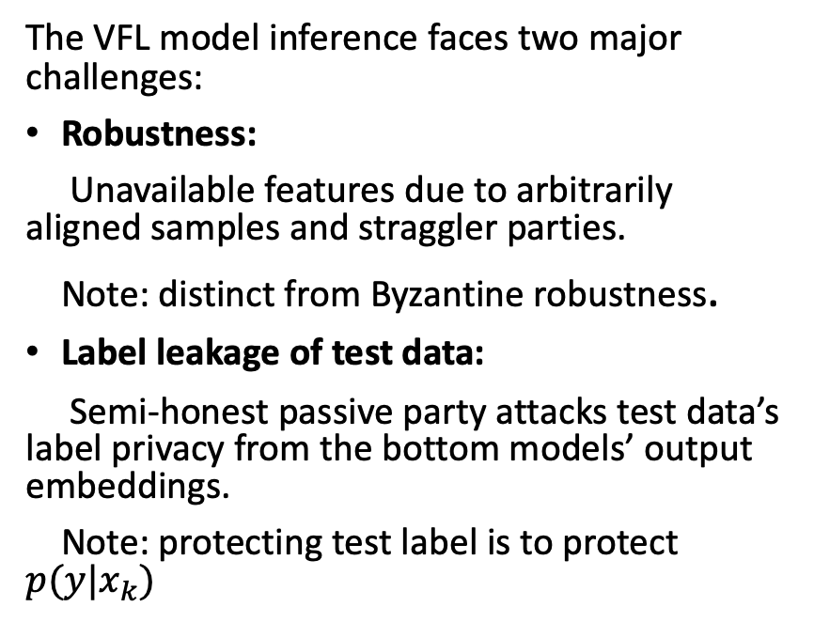
Background: Challenges
The VFL model inference faces two major challenges:
Robustness:
Unavailable features due to arbitrarily aligned samples and straggler parties.
Note: distinct from Byzantine robustness.
Label leakage of test data:
Semi-honest passive party attacks test data’s label privacy from the bottom models’ output embeddings.
Note: protecting test label is to protect $p(y|x_{k})$
Figure 4.1. VFL inference challenges
Notes:
Let’s consider the online model inference stage after a VFL model is well trained.
Ideally, to infer a test sample, the active party first broadcasts the sample ID to all passive parties.
Each passive party finds the corresponding auxiliary features and computes the output embeddings by using their bottom models.
Finally, the active party receives the embeddings from all passive parties and computes the federated prediction.
However, in practice, there are two major challenges:
First, the some passive parties may not have the corresponding auxiliary features. And some stragglers may not response timely.
Therefore, the unaligned or partially aligned data leads to robustness challenge.
Second, a semi-honest passive party may attack test data’s label privacy from it bottom model’s output embeddings, leading to label privacy leakage challenge.

Slide 32
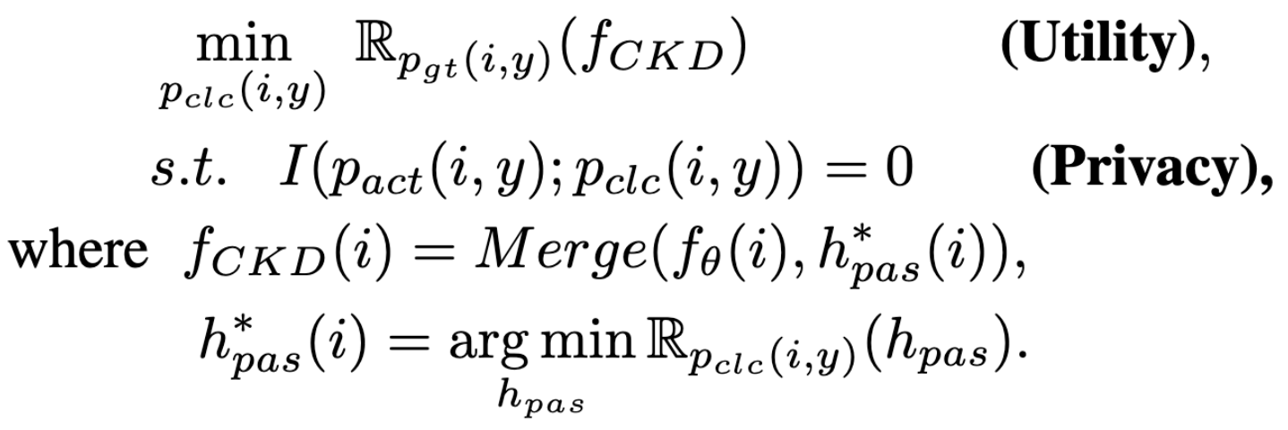
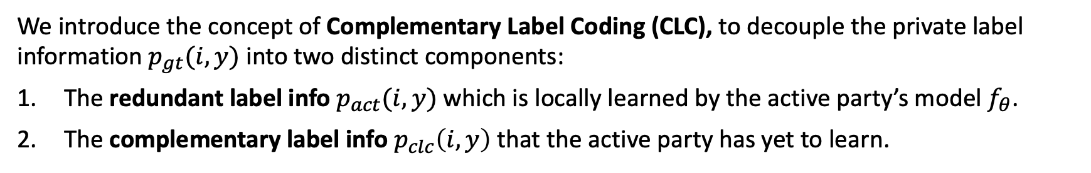
Complementary Label Coding (CLC)
We introduce the concept of Complementary Label Coding (CLC), to decouple the private label information $p_{gt}(i,y)$ into two distinct components:
The redundant label info $p_{act}(i,y)$ which is locally learned by the active party’s model $f_{θ}$.
The complementary label info $p_{clc}\left(i,y\right)$ that the active party has yet to learn.
We formulate the CLC objective with a mutual information constraint as follows:
(necessary)
Necessary information exposure for utility
(minimum)
Minimum information exposure for privacy
Notes:
Instead of directly optimizing the min-max objective, we introduce the concept of Complementary Label Coding (CLC), to decouple the private label information $p_{gt}(i,y)$ into two distinct components:
The redundant label information $p_{act}(i,y)$ which is locally learned by the active party’s model $f_{θ}$.
The complementary label information $p_{clc}\left(i,y\right)$ that the active party has yet to learn.

Slide 33
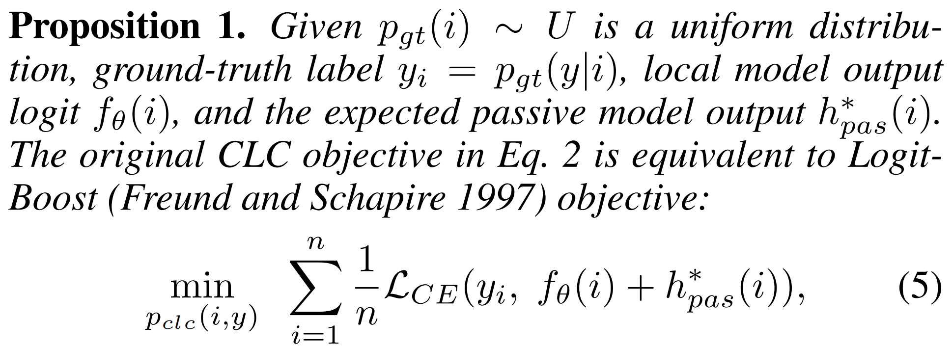
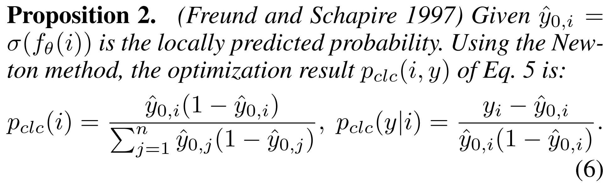
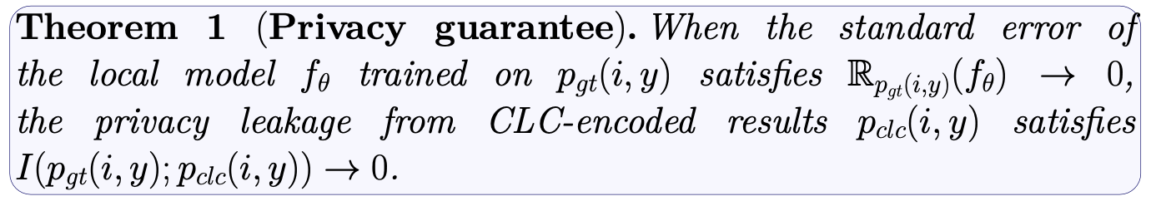
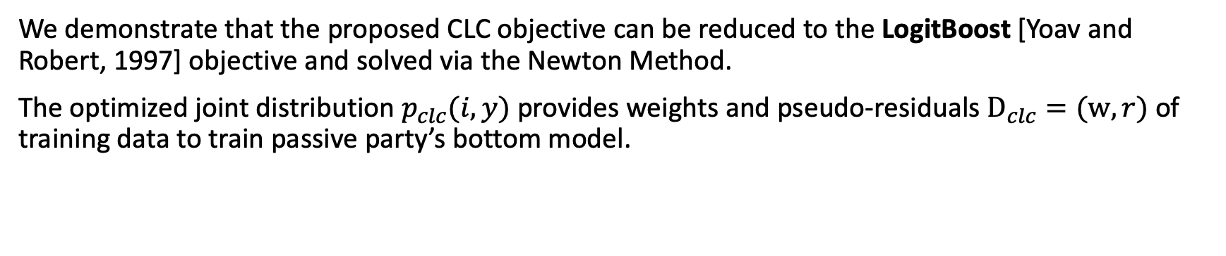
Complementary Label Coding (CLC)
We demonstrate that the proposed CLC objective can be reduced to the LogitBoost [Yoav and Robert, 1997] objective and solved via the Newton Method.
The optimized joint distribution $p_{clc}(i,y)$ provides weights and pseudo-residuals $D_{clc}=(w,r)$ of training data to train passive party’s bottom model.
Sample weights
Pseudo-residuals
Yoav Freund and Robert E Schapire. A Decision-Theoretic Generalization of On-Line Learning and an Application to Boosting. Journal of Computer and System Sciences, 55(1):119–139, 1997.
Notes:
We demonstrate that the proposed CLC objective can be reduced to the LogitBoost [3] objective and solved via the Newton Method.
The optimized joint distribution $p_{clc}(i,y)$ provides weights and pseudo-residuals $D_{clc}=(w,r)$ of training data to train passive party’s bottom model.
When the standard error of the active party’s local model trained approximates zero, the privacy leakage of from CLC-encoded joint distribution p_clc approximates zero.

Slide 34
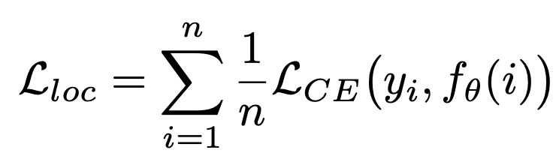
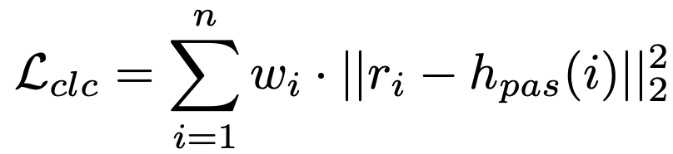
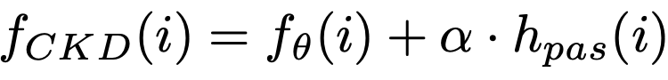
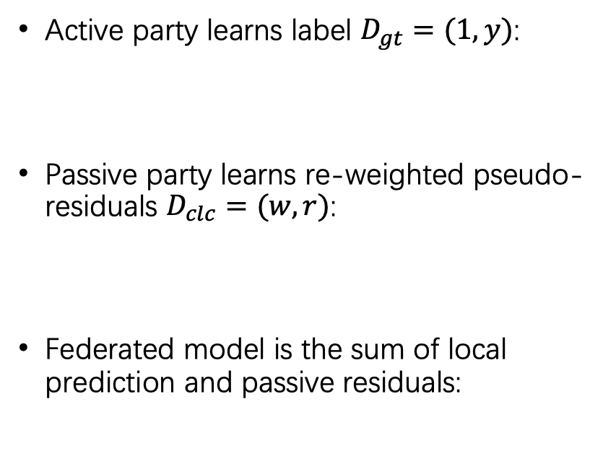
Protect Label Privacy via CLC
Active party learns label $D_{gt}=(1,y)$:
Passive party learns re-weighted pseudo-residuals $D_{clc}=(w,r)$:
Federated model is the sum of local prediction and passive residuals:
Figure 4.3: CLC-based VFL
Notes:
With the proposed complementary label coding approach, we can train the local model and the passive party’s bottom models
by using different objectives.
For simplicity, we first consider a single passive-party scenario.
The local model is trained on the ground truth joint distribution to predict labels.
While the passive party learns re-weighted pseudo-residuals.
And the federated prediction is the sum of the local predictions and passive party’s predicted pseudo-residuals.

Slide 35
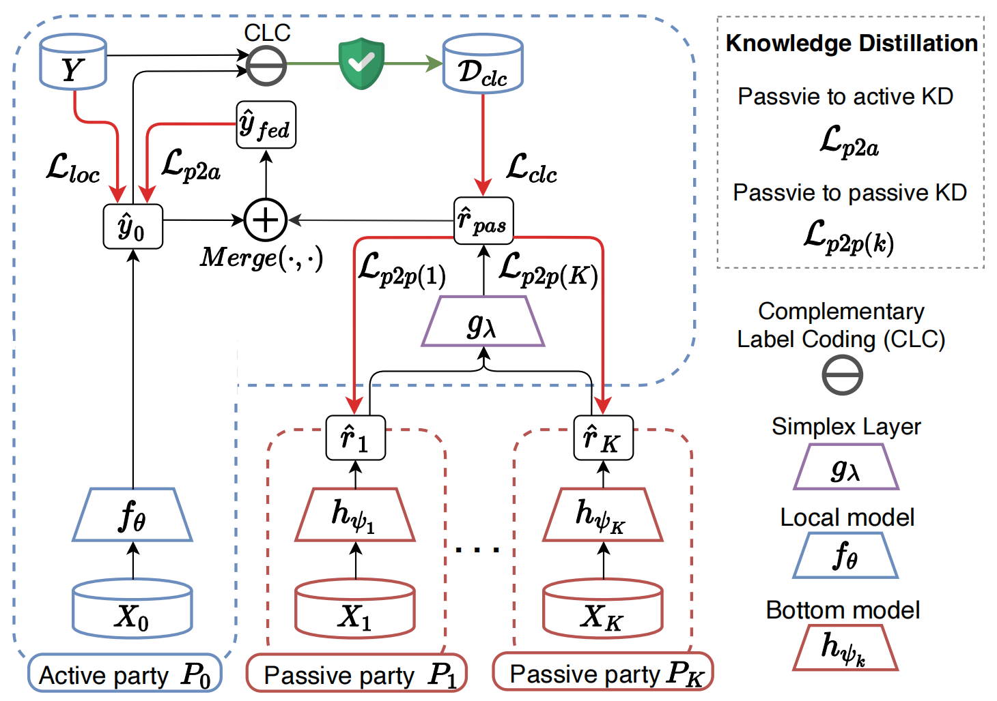
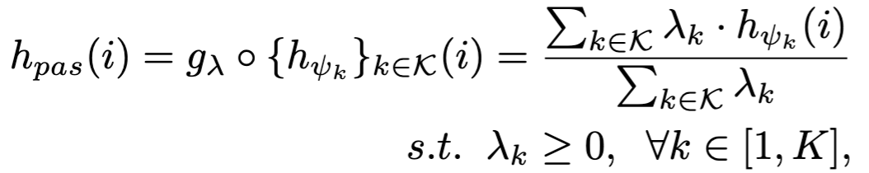
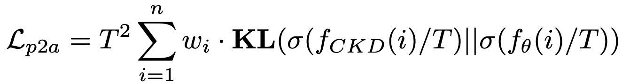
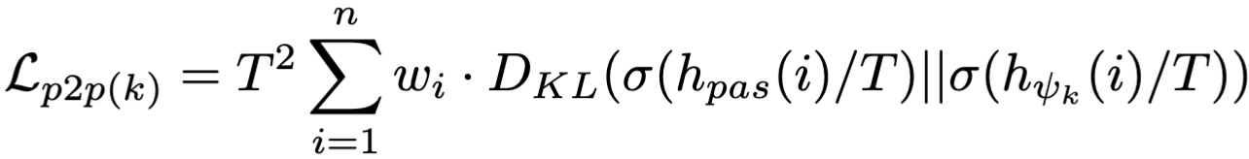
CKD for Robust Model Inference
To address robustness against partially-aligned data, we use online ensemble distillation to distill the aggregated residual among parties.
Robustly aggregated teacher residuals:
Passive-to-active distillation:
Passive-to-passive distillation:
Figure 4.4: Overview of proposed CKD
Notes:
Further more, when it comes to the multi-passive party scenario,
we leverage the idea of online ensemble distillation to distill the aggregated residual to each passive party’s bottom model.
We first robustly aggregate the teacher residuals via a simplex layer, where the outputs from the aligned passive parties are aggregated with normalization.
Then, we use the ensemble pseudo residuals as teacher residuals for knowledge distillation.

Slide 36
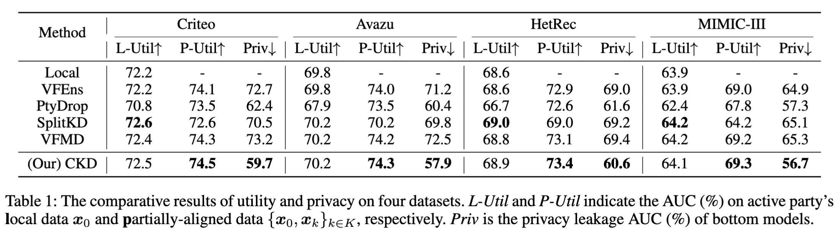
Experiments: Privacy-Robustness Trade-off
The comparative results of utility and privacy on four datasets.
CKD protects label privacy via CLC and improves robustness (utility) via distilling knowledge to the local model.
Notes:
We conducted our experiments on four dataset.
We evaluate the AUC of the federated model on arbitrarily-aligned test data. Higher AUC values indicate superior model utility.
For privacy evaluation, we calculate the average AUC of the label predictions made by the passive parties via Passive Model Completion (PMC) attack.
An ideal privacy leakage AUC value is close to 0.5.

Slide 37

Experiments: Impact of KD Losses
Passive-to-active KD:
Improve local utility and privacy by transferring complementary label knowledge.
Passive-to-passive KD:
Improve partially-aligned utility and decrease privacy. Trade privacy for robustness.

Slide 38
Conclusion
Key insight: In VFL, passive parties should only learn and transfer the “complementary label information”, which is minimum-necessary and not learned by the active party’s local model.
Contributions:
We introduce the Complementary Label Coding (CLC) that generates re-weighted pseudo-residuals for label privacy protection.
We propose Complementary Knowledge Distillation (CKD) to transfer complementary label knowledge to improve robustness.

Slide 39
Contents
5. VFDC: Secure Dataset Condensation for Privacy-Preserving and Efficient VFL
Notes:
In the next chapter, we explore the inter-sample data exposure and propose Vertical Federated Dataset Condensation (VFDC) to improve privacy and efficiency in VFL.

Slide 40

Motivation
Vanilla VFL methods train models on the entire real dataset.
However, they face a dual challenge of
real-data privacy,
training-phase efficiency.
Therefore, we aim to address this dual challenge by securely generating a small synthetic dataset to eliminate inter-sample data exposure.
Figure 5.1: Schematic comparison between vanilla VFL and VFDC. (a) Vanilla VFL trains on the entire real dataset. (b) Our VFDC securely generates a small synthetic dataset.
Notes:
We consider a VFL setting with two parties, the passive party holds features and the active party holds labels of the same set of users.
Vanilla VFL methods train models on the entire real dataset. However, they face two major challenges:
real-data privacy may be leaked to the other party.
the large data size leads to inefficient training
If we can somehow securely transform the large-scale real dataset T into a small synthetic dataset S,
then the user-specific data privacy and the training efficiency issues can be tackled simultaneously.
Therefore, we aim to address this dual challenge by securely generating a small synthetic dataset to eliminate the inter-sample data exposure.

Slide 41


Problem Definition
Utility objective: The federated model trained on synthetic dataset $𝒮$ has high utility on real data distribution:
Privacy objective:
No feature and label privacy leakage during class-wise secure aggregation.
Feature privacy satisfies differential privacy (DP).
Efficiency objective:
Minimize the training iterations to converge.

Slide 42


Preliminary
Dataset condensation (DC) aims to generate a significantly smaller condensed dataset S, with |S| ≪ |T|.
Objective: The model trained on the condensed dataset S achieves a comparable performance to that trained on the entire dataset T.
We minimize the Maximum Mean Discrepancy (MMD) Loss:

Slide 43


Proposed VFDC Method
MMD loss:
Left: The passive party computes the DP-protected embeddings of real features.
Middle: Two parties engage in class-wise secure aggregation.
Right: Active party computes MMD loss and sends back gradients.
Figure 5.3

Slide 44


Privacy Analysis
Class-wise secure aggregation protects sample-wise embeddings and labels.
Feature Privacy protection:
1) Secure aggregation + DP enables smaller noise:
2) Repetitive random model initialization:
The continuously re-initialized embedding extraction model makes it challenging to reconstruct the real features from embeddings.

Slide 45


Experimental Results
RQ1: What is the visual quality of VFDC-generated dataset?
Figure 5.4: Visualization of the VFDC-generated synthetic images.
Figure 5.5: Visualization of the distribution of the original dataset and the condensed dataset by VFDC on two datasets using t-SNE. The star-shaped points denote the VFDC-generated samples.

Slide 46

Experimental Results
RQ2: What is the privacy-utility trade-off of VFDC compared to other methods on different datasets?
Table 5.1: Comparison of accuracy (utility) of models trained by datasets generated via different methods.

Slide 47

Experimental Results
RQ3: How does VFDC improve training efficiency compared to other methods?
Figure 5.6: Performance variation of the VFL model trained using dataset output by different methods across iterations.

Slide 48
Conclusion
To address the dual challenges of privacy and efficiency in VFL, we present VFDC for small synthetic dataset generation.
VFDC has three-fold mixed protection mechanism, merging class-wise secure aggregation, DP, and repetitive model initialization.
Experimental results show that VFDC achieves high training efficiency, sample-level data privacy, and utility.

Slide 49
Contents
6. PP-HFTL: Privacy-Preserving Heterogeneous Federated Transfer Learning (IEEE Big Data 2019)

Slide 50
















Motivation and Challenges
An example [Zhang et al., 2022] of feature-sharing HFTL in healthcare scenario:
Common features with covariate shift
Heterogeneous features in each party
No semi-trusted third party
Common features
Heterogeneous features
Label
age, gender, etc.
prescription, diet, blood pressure
mortality rate
Source Party
$$S$$
Hospital
$$X_{ST}$$
$$X_{S}$$
$$X_{T}$$
Target Party
$$T$$
Health Insurance
Covariate shift
Feature heterogeneity
R. Zhang, H. Li, M. Hao, H. Chen and Y. Zhang, "Secure Feature Selection for Vertical Federated Learning in eHealth Systems," ICC 2022 - IEEE International Conference on Communications, Seoul, Korea, Republic of, 2022, pp. 1257-1262, doi: 10.1109/ICC45855.2022.9838917.
Notes:
Here is an example in the healthcare scenario,
a hospital and a health insurance want to conduct federated learning to train a ML model to predict the mortality.
However, they only share limited common features with covariate shift, such as age and gender.
Moreover, most features are unique to certain parties, thus are heterogeneous.

Slide 51










PP-HFTL Phase 1: Secure Transfer Learning
Secure domain adaptation
Compute instance weight $⟨α⟩$ by training a domain classifier via SLR.
Domain classifier $⟨w_{D}⟩$
instance
weights
Secure Logistic Regression
$$⟨α⟩$$
$${⟨X}_{ST}⟩$$
$$⟨X_{ST}⟩$$
Hospital
Health Insurance
Source Party $S$
Target Party $T$
Figure 6.1
Notes:
And are estimated by polynomial approximation.

Slide 52










PP-HFTL Phase 1: Secure Transfer Learning
Secure feature mapping
Each party locally learns a linear regression model for feature mapping.
$$⟨θ^{S}⟩$$
$$⟨θ^{T}⟩$$
$$⟨α⟩$$
$${⟨X}_{ST}⟩$$
$$⟨X_{S}⟩$$
?
$$⟨X_{ST}⟩$$
?
$${⟨X}_{T}⟩$$
Hospital
Source Party $S$
Target Party $T$
Health Insurance
Figure 6.2
Notes:
And are estimated by polynomial approximation.

Slide 53











PP-HFTL Phase 1: Secure Transfer Learning
Secure feature mapping
Each party locally learns a linear regression model for feature mapping.
Do private feature inference.
$$⟨θ^{T}⟩$$
$$⟨θ^{S}⟩$$
$$⟨α⟩$$
$${⟨X}_{ST}⟩$$
$$⟨X_{S}⟩$$
$$⟨\hat{X_{T}}⟩$$
$$⟨X_{ST}⟩$$
$$⟨\hat{X_{S}}⟩$$
$${⟨X}_{T}⟩$$
Hospital
Source Party $S$
Target Party $T$
Health Insurance
Figure 6.3
Notes:
And are estimated by polynomial approximation.

Slide 54












PP-HFTL Phase 2: Secure Federated Learning
Parties conduct secure logistic regression to train label prediction model ⟨𝑤⟩
$$⟨w⟩$$
Secure Logistic Regression
$$⟨α⟩$$
$${⟨X}_{ST}⟩$$
$$⟨X_{S}⟩$$
$$⟨\hat{X_{T}}⟩$$
$$⟨Y⟩$$
$$⟨X_{ST}⟩$$
$$⟨\hat{X_{S}}⟩$$
$${⟨X}_{T}⟩$$
$$⟨Y⟩$$
Source Party $S$
Target Party $T$
Health
Insurance
Hospital
Figure 6.4
Notes:
In the secure federated learning phase, a secure logistic regression model is trained collaboratively over all the features to predict the label Y.

Slide 55







PP-HFTL Phase 3: Secure Model Integration
Label inference requires $⟨θ^{S}⟩$ and $\left\langle w\right\rangle$, which is inefficient.
Target party T inference process:
$$⟨θ^{S}⟩$$
$$⟨X_{ST}⟩$$
$$⟨\hat{X_{S}}⟩$$
$${⟨X}_{T}⟩$$
$$?$$
$$⟨w⟩$$
Figure 6.5
Notes:
Now, a party can conduct label inference as shown in the figure. The prediction involves two secure model inference processes, which is inefficient.
*
We find that, the secret feature mapping model and the label inference model can be integrated safely as bellows.
By revealing the plain-text model w_T to the target party, the target party can conduct label inference on its own data locally and efficiently.

Slide 56



PP-HFTL Phase 3: Secure Model Integration
Label inference requires $⟨θ^{S}⟩$ and $\left\langle w\right\rangle$, which is inefficient
Integrate $⟨θ^{S}⟩$ and $⟨w⟩$ and reveal $w^{T}$ to target party $T$.
Party T can do label inference locally with $w^{T}$: $\hat{Y}=Sigmoid(X⋅w^{T})$
Notes:
Now, a party can conduct label inference as shown in the figure. The prediction involves two secure model inference processes, which is inefficient.
*
We find that, the secret feature mapping model and the label inference model can be integrated safely as bellows.
By revealing the plain-text model w_T to the target party, the target party can conduct label inference on its own data locally and efficiently.

Slide 57


Experiments Performance of transfer learning
PP-HFTL with secure domain adaptation is robust to covariate shift
Spambase
WDBC
PP-HFTL with secure feature mapping is robust to feature heterogeneity
Spambase
WDBC
Figure 6.6
Notes:
The performance of transfer learning is studied by adjusting the KL divergence and common feature ratio.
It can be observed that the HFTL is robust to both covariate shift and feature heterogeneity, compared to federated learning based on common features and local learning.

Slide 58





Experiments Efficiency and scalability of HFTL
Secret sharing-based HFTL is 20x more efficient than HE-based PP-HFTL.
SS-based HFTL
HE-based HFTL
$O(nm)$ complexity to batch size $n$ and feature number $m$.
time vs. batch size $n$
time vs. # features $m$
Figure 6.7
Notes:
Both secret sharing-based HFTL and HE-based HFTL are implemented and we find that SS based HFTL is around 20x faster than the HE-based HFTL.
The iteration time grows linearly with the batch size and feature number.

Slide 59
Conclusion
We propose heterogeneous federated transfer learning (PP-HFTL) to enable secure VFL to address covariate shift and feature space heterogeneity.
Two variants of PP-HFTL are proposed without introducing a collaborator.
The final model achieves minimum-necessary model exposure for efficient inference.
Experiments on four datasets demonstrate our approach can transfer knowledge from other parties with practical efficiency and scalability.

Slide 60
Contents
1. Introduction
2. Vertical Federated Learning
3. LPSC: Label Privacy Source Coding in VFL (ECML PKDD 2024)
4. CKD: Complementary Knowledge Distillation in VFL (AAAI 2024)
5. VFDC: Secure Dataset Condensation for Privacy-Preserving and Efficient VFL
6. PP-HFTL: Privacy-Preserving Heterogeneous Federated Transfer Learning (IEEE Big Data 2019)
7. Conclusions

Slide 61
Conclusions
We propose a unique taxonomy of information exposure in VFL.
Our four studies on minimum-necessary information exposure (MNIE) explore VFL from three aspects:
Various types of information exposure
More objectives.
More complex settings.
More Objectives
 | Privacy & Utility | Privacy & Utility & Robustness | Privacy & Utility & Efficiency
Vanilla VFL | LPSC (Intra-Exp) ECML PKDD 24 |  | VFDC (Inter-Exp) ECML PKDD 24
Sample-sharing HFTL |  | CKD (Intra-Exp) AAAI 24
Feature-sharing HFTL | PP-HFTL (Model-Exp) IEEE Big Data 19
More
Complex
Settings
Intra-Exp: Intra-sample exposure, Inter-Exp: inter-sample exposure, Model-Exp: model exposure.

Slide 62
References
Qiang Yang, Yang Liu, Tianjian Chen, and Yongxin Tong. Federated machine learning: Concept and applications. ACM Trans. Intell. Syst. Technol., 10(2), Jan 2019.
Visa Research. (2023). Secure collaborative machine learning. https://usa.visa.com/dam/VCOM/regional/na/us/about-visa/research/documents/ secure-collaborative-machine-learning.pdf
Jung Hee Cheon, Andrey Kim, Miran Kim, and Yongsoo Song. Homomorphic encryption for arithmetic of approximate numbers. In International conference on the theory and application of cryptology and information security, pages 409–437. Springer, 2017.
Fangcheng Fu, Yingxia Shao, Lele Yu, Jiawei Jiang, Huanran Xue, Yangyu Tao, and Bin Cui. Vf2boost: Very fast vertical federated gradient boosting for cross-enterprise learning. In Proceedings of the 2021 International Conference on Management of Data, pages 563–576, 2021.
Chong Fu, Xuhong Zhang, Shouling Ji, Jinyin Chen, Jingzheng Wu, Shanqing Guo, Jun Zhou, Alex X. Liu, and Ting Wang. Label inference attacks against vertical federated learning. In 31st USENIX Security Symposium (USENIX Security 22), pages 1397–1414, Boston, MA, August 2022. USENIX Association.
Cynthia Dwork, Frank McSherry, Kobbi Nissim, and Adam Smith. Calibrating noise to sensitivity in private data analysis. In Proc. of Theory of cryptography conference, 2006.
Dashan Gao, Sheng Wan, Lixin Fan, Xin Yao, and Qiang Yang. Complementary Knowledge Distillation for Robust and Privacy-Preserving Model Serving in Vertical Federated Learning. AAAI, 2024.
Dashan Gao, Sheng Wan, Hanlin Gu, Lixin Fan, Xin Yao, and Qiang Yang. Label Privacy Source Coding in Vertical Federated Learning. ECML PKDD 2024.
Dashan Gao, Canhui Wu, Xiaojin Zhang, Xin Yao, and Qiang Yang. Secure Dataset Condensation for Privacy-Preserving and Efficient Vertical Federated Learning. ECML PKDD 2024.
Dashan Gao, Yang Liu, Anbu Huang, Ce Ju, Han Yu, and Qiang Yang. Privacy-preserving heterogeneous federated transfer learning. In 2019 IEEE International Conference on Big Data (Big Data), pages 2552–2559, 2019.

Slide 63
References
Dashan Gao, Ce Ju, X. Wei, Y. Liu, Tianjian Chen, and Q. Yang. HHHFL: Hierarchical heterogeneous horizontal federated learning for electroencephalography. ArXiv, abs/1909.05784, NeurIPS FL Workshop, 2019
Dashan Gao, Ben Tan, Ce Ju, Vincent Zheng, and Qiang Yang. Federated Factorization Machine for Secure Recommendation with Sparse Data. AAAI RSML Workshop, Virtual, 2021.
Keith Bonawitz, Vladimir Ivanov, Ben Kreuter, Antonio Marcedone, H. Brendan McMahan, Sarvar Patel, Daniel Ramage, Aaron Segal, and Karn Seth. 2017. Practical Secure Aggregation for Privacy-Preserving Machine Learning. In Proceedings of the 2017 ACM SIGSAC Conference on Computer and Communications Security (CCS '17).
Arthur Gretton, Karsten Borgwardt, Malte Rasch, Bernhard Schölkopf, and Alex J Smola. A kernel method for the two-sample-problem. In Advances in neural information processing systems, pages 513–520, 2007.
Zhenghang Ren, Liu Yang, & Kai Chen(2022). Improving Availability of Vertical Federated Learning: Relaxing Inference on Non-overlapping Data. ACM Transactions on Intelligent Systems and Technology (TIST).
Di Chai, Leye Wang, Kai Chen and Qiang Yang, "Secure Federated Matrix Factorization," in IEEE Intelligent Systems, vol. 36, no. 5, pp. 11-20, 1 Sept.-Oct. 2021, doi: 10.1109/MIS.2020.3014880
Di Chai, Leye Wang, J. Zhang, Liu Yang, S. Cai, Kai Chen, & Qiang Yang. (2022, August). Practical Lossless Federated Singular Vector Decomposition over Billion-Scale Data. In Proceedings of the 28th ACM SIGKDD Conference on Knowledge Discovery and Data Mining (pp. 46-55).
Kewei Cheng, Tao Fan, Yilun Jin, Yang Liu, Tianjian Chen, Dimitrios Papadopou- los, and Qiang Yang. Secureboost: A lossless federated learning framework. IEEE Intelligent Systems, 36(6):87–98, 2021.
Oscar Li, Jiankai Sun, Xin Yang, Weihao Gao, Hongyi Zhang, Junyuan Xie, Virginia, Smith, and Chong Wang. Label leakage and protection in two-party split learning. International Conference on Learning Representations (ICLR), 2022.

Slide 64
Thank You
Q & A

Slide 65
Backup slides

Slide 66
Comparison of Information Exposures

Slide 67
Summary of This Thesis
One topic:
Minimum Exposure Approach to Trustworthy VFL.
Goal: Minimizing information exposure to improve trade-offs in VFL.
Three dimensions:
Exposure Types: Intra-sample exposure, Inter-sample exposure, Model exposure.
Objectives: Utility, Privacy, Efficiency, Robustness, ...
VFL Settings: Vanilla VFL, Heterogeneous Federated Transfer Learning.
Four works:
Papers | Conference | Targeted Exposure | Objectives | VFL Setting
LPSC | ECML PKDD | Intra-sample exposure | Privacy & Utility | Vanilla VFL
CKD | AAAI | Intra-sample exposure | Privacy & Utility & Robustness | Sample-sharing HFTL
PP-HFTL | IEEE Big Data | Data & Model exposure | Privacy & Utility | Feature-sharing HFTL
VFDC | ECML PKDD | Inter-sample exposure | Privacy & Utility & Efficiency | Vanilla VFL
Notes:
Done: MNIP
Minimum-Necessary Information exposure
分叉成 保护数据 DE, 和 模型参数 ME.

Slide 68

Strategies for Multi-objective Trade-offs
The design of VFL algorithms is to search for a Pareto front in the multi-objective trade-off space.
There are two strategies to optimize the VFL approach:
Identify and reduce unnecessity, e.g., reduce unnecessary (redundant) communications and cryptographic operations[Fu et al. 2021].
Find the knee point. Trade one objective with a little decline for another with significant benefit [Cheon et al. 2017].
We focus on the first strategy by proposing MNIE.
Fangcheng Fu, Yingxia Shao, Lele Yu, Jiawei Jiang, Huanran Xue, Yangyu Tao, and Bin Cui. Vf2boost: Very fast vertical federated gradient boosting for cross-enterprise learning. In Proceedings of the 2021 International Conference on Management of Data, pages 563–576, 2021.
Jung Hee Cheon, Andrey Kim, Miran Kim, and Yongsoo Song. Homomorphic encryption for arithmetic of approximate numbers. In International conference on the theory and application of cryptology and information security, pages 409–437. Springer, 2017.
Notes:
Given the multiple-objectives in trustworthy VFL, the design of VFL algorithms is to search for a Pareto front in trade-off space.
There are two strategies to optimize the VFL approach:
First, we can identify and reduce the unnesessity,such as reducing redundant communications and cryptographic operations.
We can also find the knee point by trading one objective with a little decline for another with significant benefit.
In this thesis, we focus on the first strategy by proposing Minimum-Necessary Information Exposure.

Slide 69
Background of CKD
Existing studies [Li et al., 2019, Ren et al., 2020] tackle the robustness challenge via knowledge distillation.
However, they train the passive party’s bottom model to fit labels, leading to label privacy leakage from the output of passive party’s bottom model.
Our idea is to train the passive party’s bottom model to fit residuals of active party’s local model.
By doing so, the passive party only contributes residuals to the teacher model, thus protects label privacy.
Knowledge distillation
Passive objective:
Top model
Label
Residual
Active
Local Model
Active Bottom
Passive Bottom
Active party
Passive party
Figure 4.2
Li, Wenjie, et al. "Semi-supervised cross-silo advertising with partial knowledge transfer." arXiv e-prints (2022): arXiv-2205.
Ren, Zhenghang, Liu Yang, and Kai Chen. "Improving availability of vertical federated learning: Relaxing inference on non-overlapping data." ACM Transactions on Intelligent Systems and Technology (TIST) 13.4 (2022): 1-20.
Notes:
Existing studies tackle the robustness challenge by leveraging knowledge distillation.
Specifically, they train a federated model to predict the aligned data, and train a standalone local model to predict the unaligned data.
To improve the prediction performance on unaligned data, they take the federated model as teacher and transfers knowledge from the federated model to the local model.
However, they train the passive party’s bottom model to fit labels, this leads to the output embeddings highly informative about the labels and leads to label leakage from the output of passive party’s bottom model.
We realize that, the passive party should only contribute what we term as “complementary” label information, that is not yet learned by the active party’s model.
Therefore, our idea is to train the passive party’s bottom model to fit residuals of active party’s local model.
By doing so, the passive party only contributes residuals to the teacher model, thus protects label privacy while maintaining federated model utility.
The problem is that, how to construct a learning target to train passive party to learn the complementary label information?

Slide 70


Preliminary of VFDC
Setting:
Two parties: active party $P_{0}$ possesses real labels $y$, and passive party $P_{1}$ holds real features $x.$The objective in VFL is for these two parties to collaboratively train a model.
Threat Model:
‘Honest-but-curious’ assumption for all parties in VFL.
Active party seeks to infer feature privacy from the passive parties, and vice versa, the passive parties aim to infer label privacy from the active party.

Slide 71

Preliminary of VFDC
Differential Privacy (DP):
Secure Aggregation:
Secure aggregation corresponds to computing the sum of multiple inputs while keeping the individual inputs confidential.

Slide 72
Preliminary of VFDC
Dataset condensation (DC) aims to generate a significantly smaller condensed dataset S, with |S| ≪ |T|.
Objective: The model trained on the condensed dataset S achieves a comparable performance to that trained on the entire dataset T.
We minimize the Maximum Mean Discrepancy (MMD) Loss:

Slide 73


Class-wise Secure Aggregation in VFDC
Figure 5.2

Slide 74
Backup Slides on Secure Computation

Slide 75
Security and Privacy-Preservation in FL
Security Definitions:
Honest and incurious security:
The adversaries honestly follow the protocol and do not infer knowledge.
Semi-honest security:
The adversaries strictly follow the prespecified protocol without deviation. However, they will collect all received intermediate data and try to derive knowledge from it.
Malicious security:
The adversaries can arbitrarily deviate from the protocol in their attempt to cheat.
Semi-honest security attracts the most attention as
Semi-honest security balances security and efficiency.
Malicious security can be achieved by adding message commitment to semi-honest protocols.

Slide 76
Security and Privacy-Preservation in FL
General Privacy Attacks
Attack：
Model inversion attack (learn model feature representation of each class)
Data reconstruction attack (infer training data)
Membership inference attack
Phase:
Training phase/ inference phase
Access:
White box access/ black box access

Slide 77

Security and Privacy-Preservation in FL - Key Security Techniques
Secure Multi-party Computation (MPC) [Yao, 1982]
Subfield of cryptography
Enables parties to jointly compute a function over their inputs while keeping those inputs private
Low efficiency (communication cost) & no utility loss
MPC can be achieved by:
Secret sharing
Oblivious transfer
Threshold homomorphic encryption

Slide 78


Security and Privacy-Preservation in FL - Key Security Techniques
Homomorphic Encryption (HE) [Rivest et al., 1978]
Enables algebraic operations on ciphertexts
Low efficiency (computation costs) & no utility loss
Partial HE vs. Fully HE
Paillier [Paillier, 1999]
additive HE
RSA [Rivest et al., 1978]
multiplicative HE

Slide 79



Security and Privacy-Preservation in FL - Key Security Techniques
Differential Privacy (DP) [Dwork, 2006]
A randomized mechanism that protects membership information.
Guarantees an adversary cannot deduce any membership information with high confidence from released datasets, models, or gradients.
High efficiency & utility loss
$\left(ε,δ\right)$-DP:
[Bae, et al., 2018]

